Slide 1
AQP compare bef-SL vs after

Slide 2
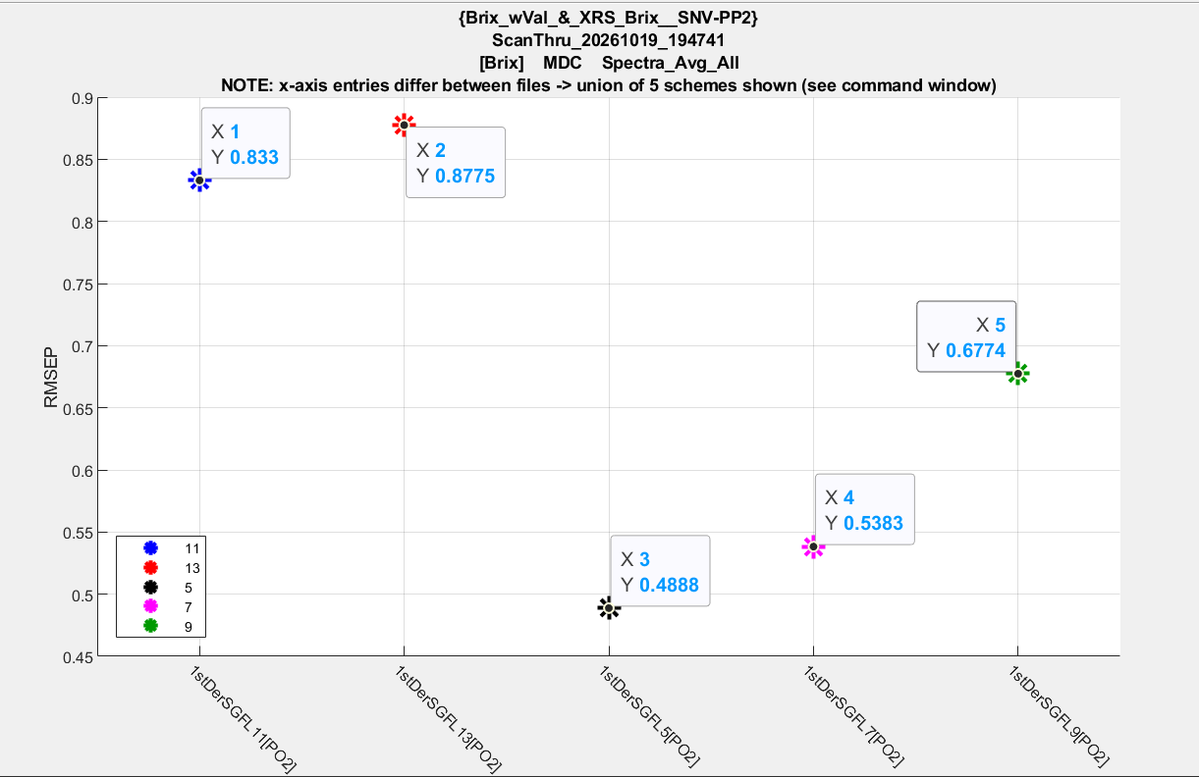
Bef-SL

Slide 3
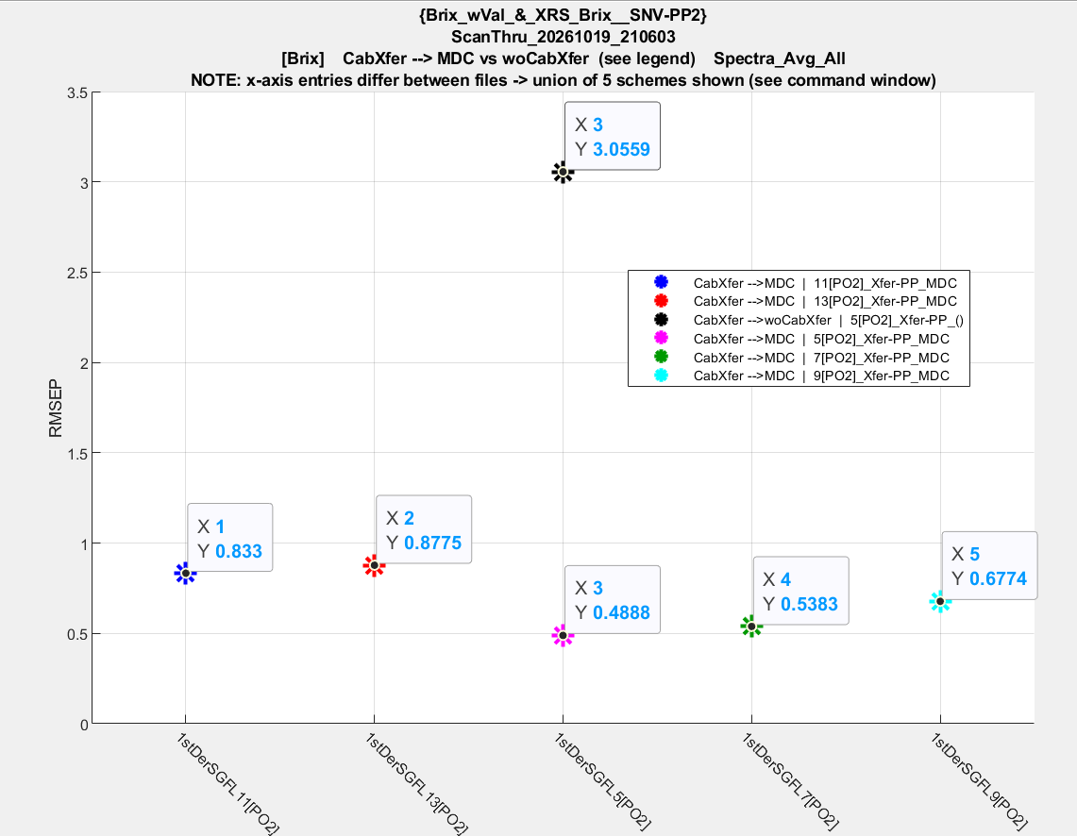
Aft-SL

